Slide 1
OQ Jams in the Waste Chute- Methods of Errors

Slide 2
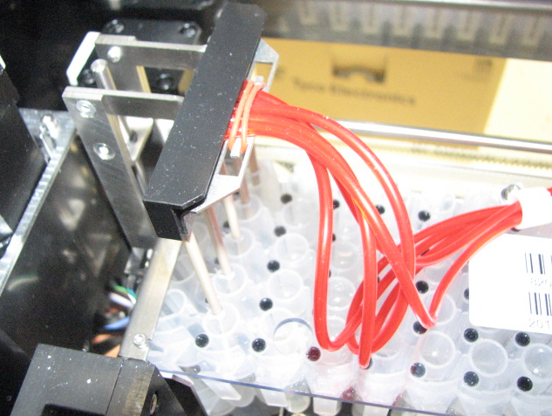
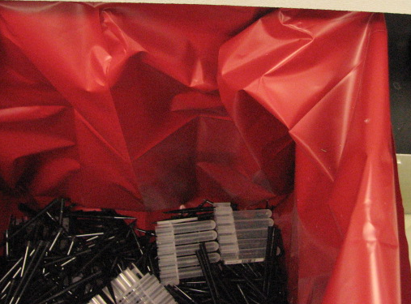
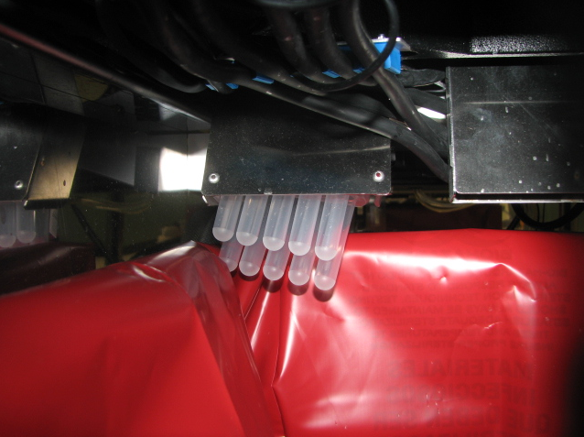
View from the top.
Problem: The Solid Waste Bag is not installed flush against the sides of the Waste Bin, then the MTU gets hung up on the bag, causing a backup.
Solution: Train the operator to properly install the Waste Bag, and make sure a Waste Bin Cover is installed.
Waste Bag is not Flush with the Waste Bin
MTU gets caught on Waste Bag

Slide 3
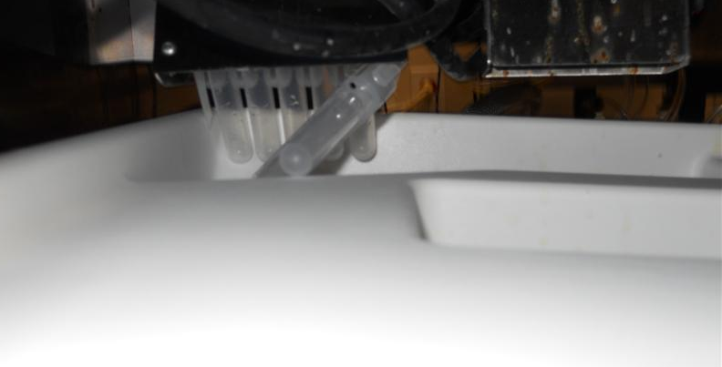
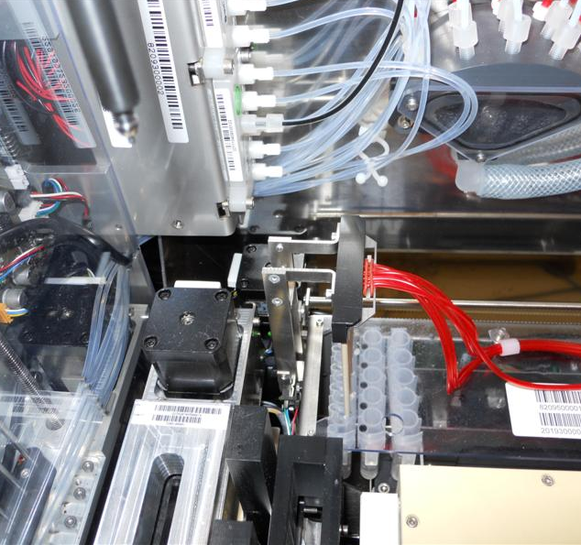
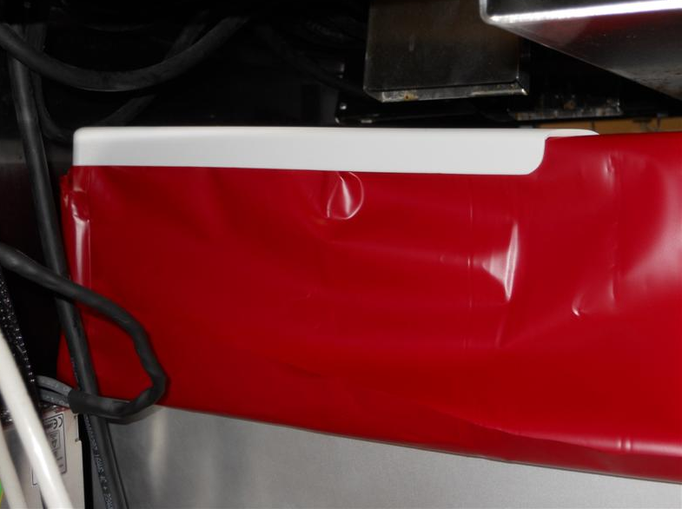
Problem: The disposable Solid Waste Bin Cover is not installed correctly. Either the cover is not pushed down completely, or it is shifted forward some (or both). This will cause MTUs to catch on the cover.
Solution: Train the operator to properly install the Waste Drawer Cover.
MTUs get caught on the waste cover.
Waste Cover is pushed forward slightly.
View From the Top.
Waste Cover is not pushed down completely.

Slide 4
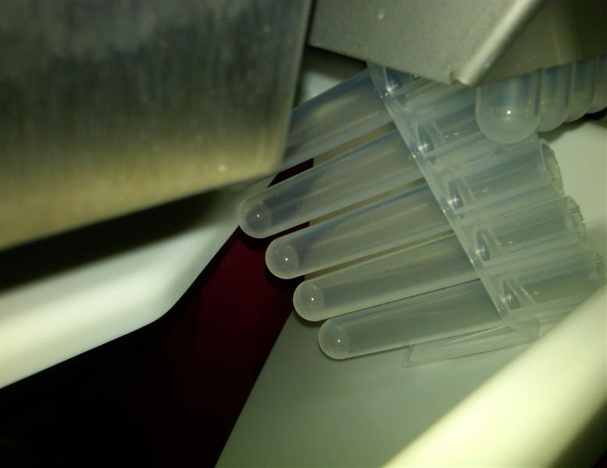
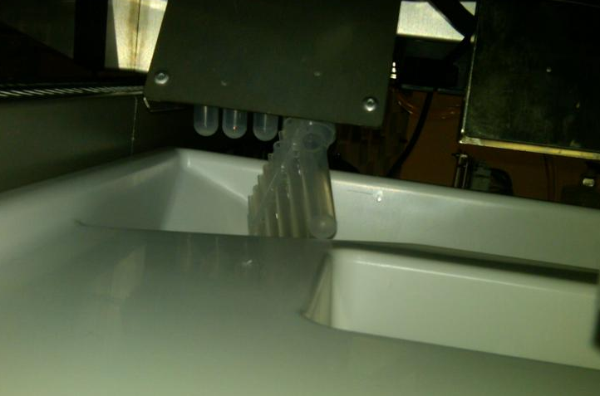
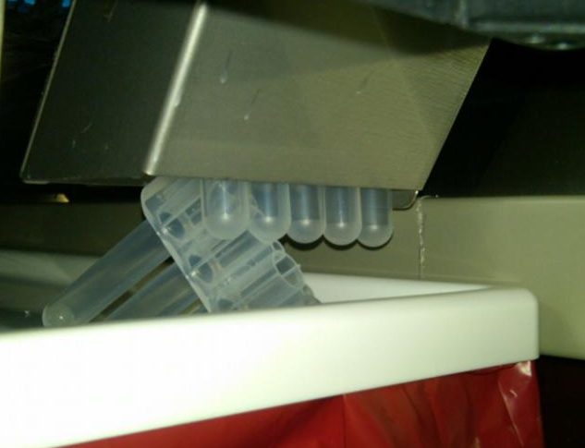
Problem: Waste Bin cover is installed correctly, but an MTU still gets caught on the Waste Bin Cover.
Solution: Clear the jam and restart the instrument. Solution is in the works at GP Engineering.

Slide 5
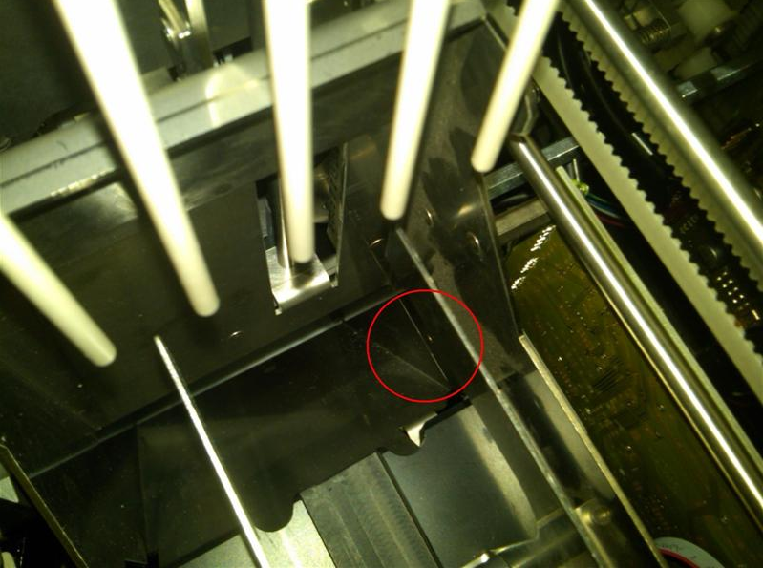
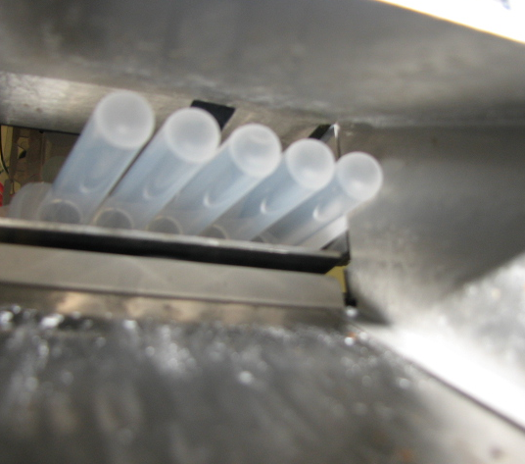
Problem: MTU gets caught on the eject chute.
Solution:
Is the Service Drawer COMPLETELY closed? Even 1 mm out can cause an issue. Also, the COP shield can cause the drawer to not close completely. Remove the shield, close the drawer, then reinstall the shield. Look down at the eject chute once this is complete. Is there a lip for the MTU to catch on?
Adjust the MTU Chute and/or OQ so that there is no lip for the MTU barcode tab to get hung up on. See GP11-236-FSN for instructions.
Eject Chute lip MTU barcode tabs can get caught on.
MTU barcode tab gets caught on the eject chute.

Slide 6
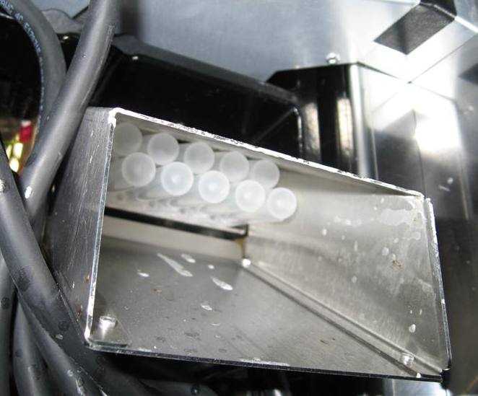
Problem: Two MTUs jam in the eject chute.
Solution: Clear the jam and restart the instrument. Solution is in the works at GP Engineering.

Slide 7
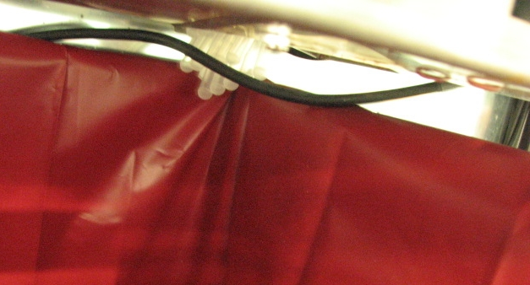
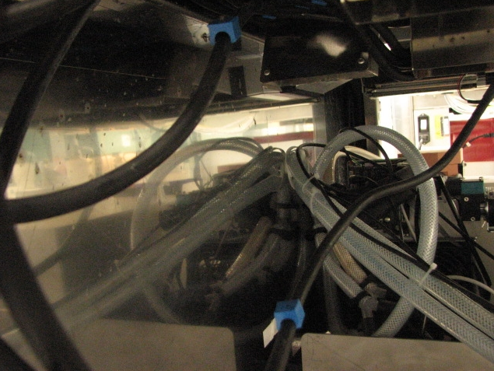
Problem: COP cable for LD (or other module) hangs down, and MTUs catch on the cable.
- Also note- If the thermistor for the chiller ramp is not properly secured, it also can cause MTUs to be hung up. The thermistor is a thin black or white wire that can hang across the exit point of the OQ.
Solution: Ensure all COP cables are properly secured to the underside of the Service Drawer, and that the Chiller ramp thermistor is tied away from the exit point of the OQ.

Slide 8
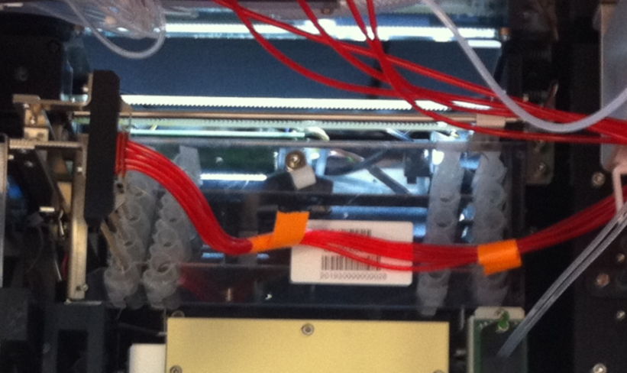
Problem: MTU is crooked under the OQ aspirators
Solution: Make sure the instrument is level. Also, report this issue to GP engineering ASAP.
MTU is crooked, so the Aspirators jam against the MTU, preventing movement into the MTU tubes.

